Slide 1
Unit 3, Spectacular Saguaros and Humans
Driving Question:
How have humans used the saguaro to help them survive in the Sonoran Desert?
Photograph by Jay Pierstorff
Notes:
Introduce the driving questions for the week.

Slide 2
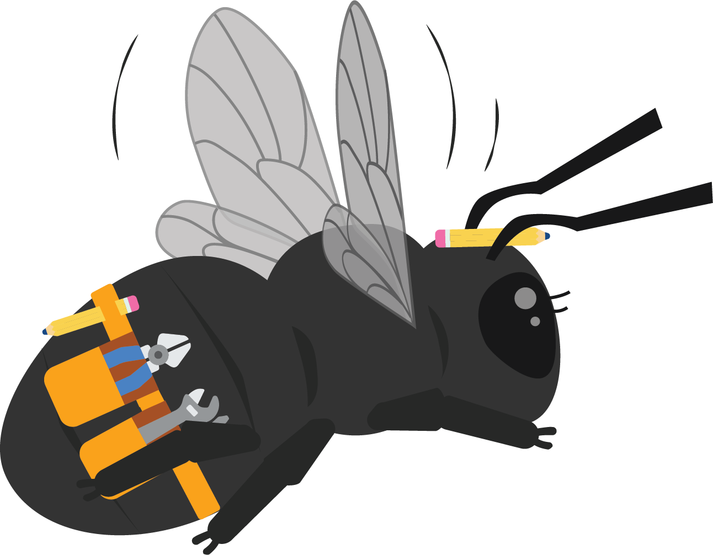
Hi 1st Graders!
Hello again! It’s Beatrice the Carpenter Bee here to help you continue learning about the Saguaro cactus!
This week we are going to talk all about how humans use the saguaro to help them survive in the Sonoran Desert.
Did you know that people have lived in the Sonoran Desert for a very long time?

Slide 3
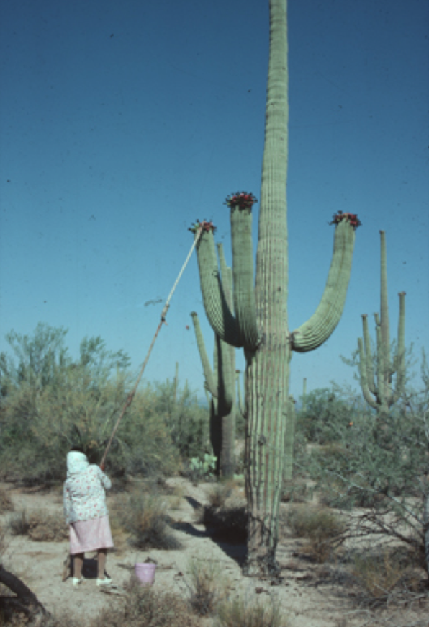
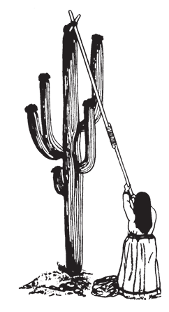
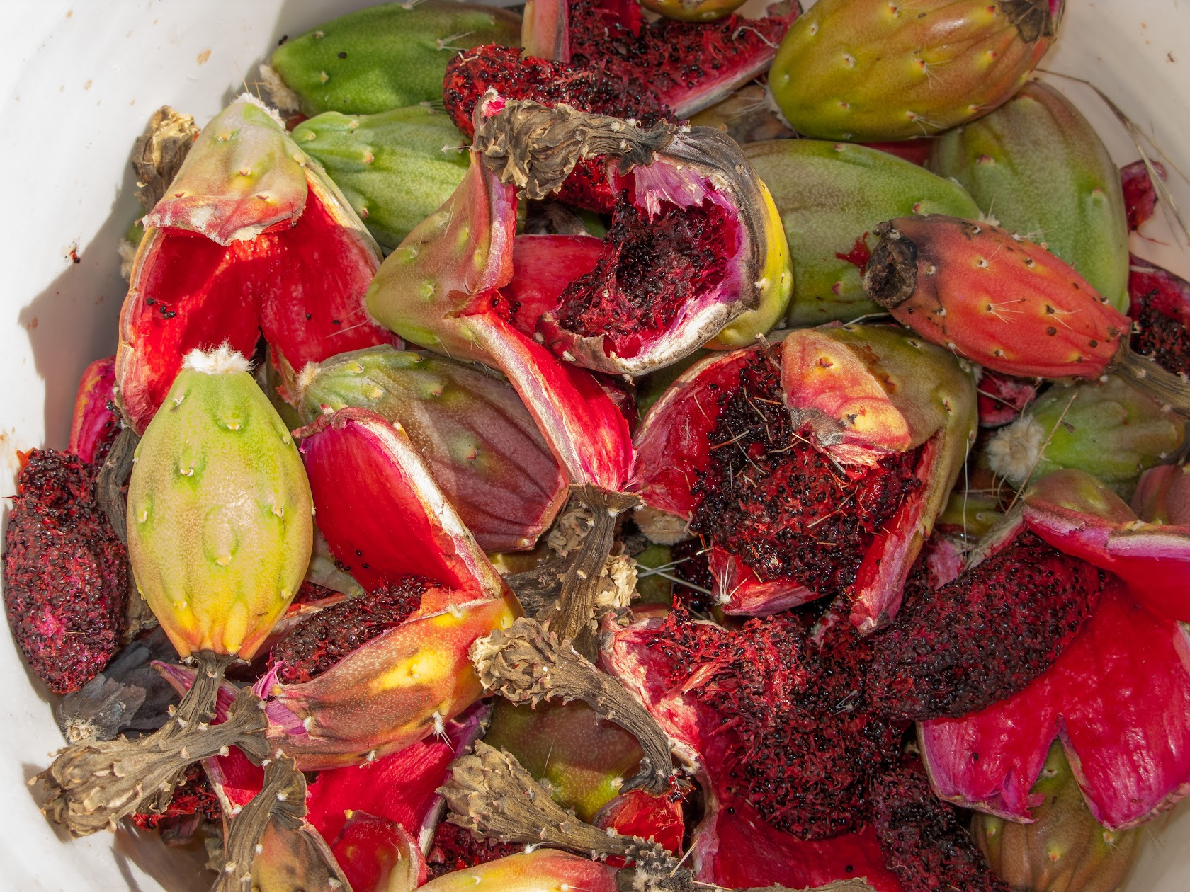
Engage
Humans Need the Saguaro
Today we will look at some pictures of humans and saguaros. As we look at them, let’s decide what we think they are doing. What do you notice about the human and the saguaro? What do you wonder?
Teacher Information Desert Discovery Class © 2000, revised 2008 ASDM
Notes:
Show students the saguaro harvesting photos. Discuss as a class: uses of the a saguaro

Slide 4
Saguaro Harvest - Simulation
Explore
I have placed a special treat up high in our room. Your job is to get the treat down to enjoy! You may NOT climb on anything to get it. You CAN use items around the room and even put them together to get the treat down.
Think: What could you do to get that treat? Let’s make a plan and try out your ideas!

Slide 5
Saguaro Harvest
Explore
Why did you work so hard to get the treat?
What was challenging about getting the items down?
How did you solve the problem of the treat being up so high?
Let’s watch a video of harvesting saguaro fruit. As you watch, pay close attention to how the people harvest! What do you notice?
https://az.pbslearningmedia.org/resource/stella-tucker-video/the-arizona-collection/?student=true&focus=true
Notes:
Show students the time lapse video of a saguaro. Have students discuss what they notice and wonder about the saguaro over time, and write their ideas down to create a “wonder wall” chart. Point student discussion towards how they visibly see the saguaro change, as well as what kinds of plants and weather they notice in the saguaro’s vicinity.

Slide 6
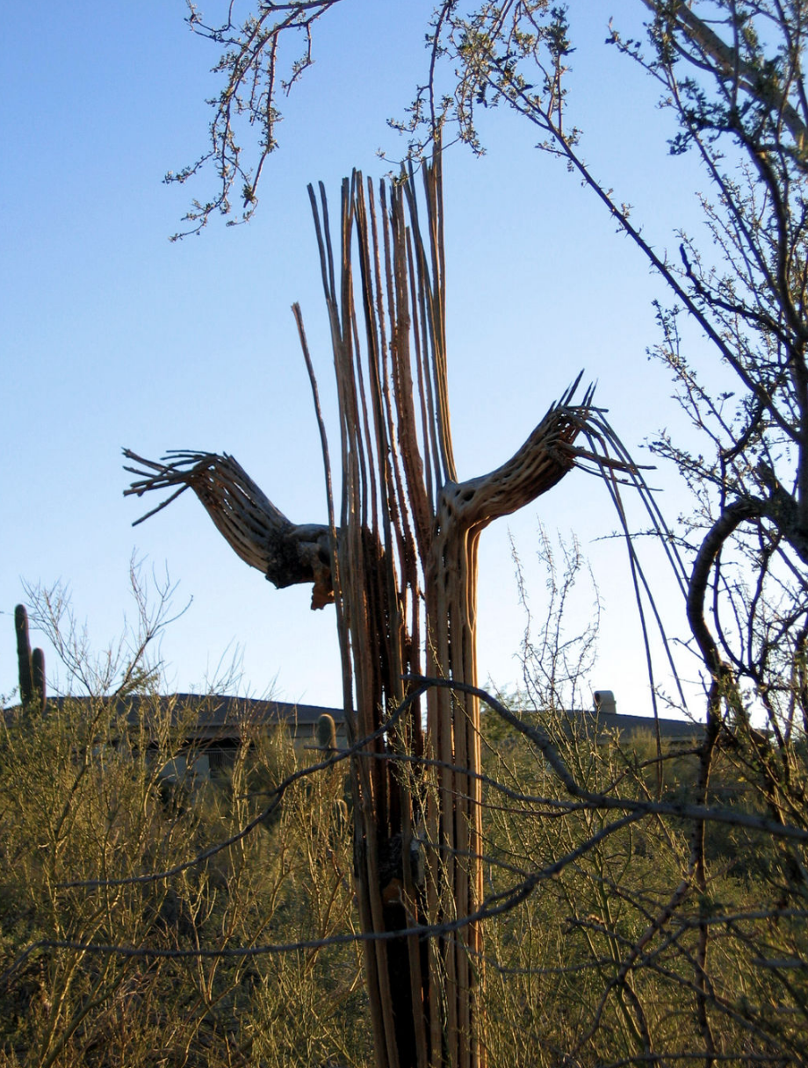
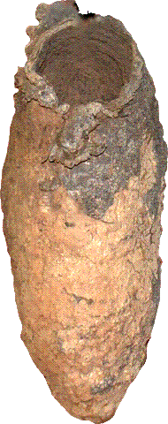
Saguaro Harvest
Explore
The fruit is not the only part of the saguaro that people have used. Look at a saguaro. What else could be helpful to humans? How could we use these parts of the saguaro?
This is a saguaro boot (where birds made a nest). How could humans use this?

Slide 7
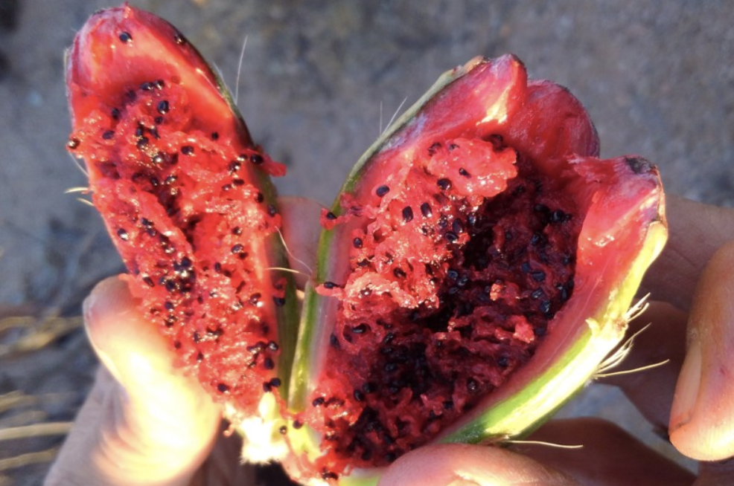
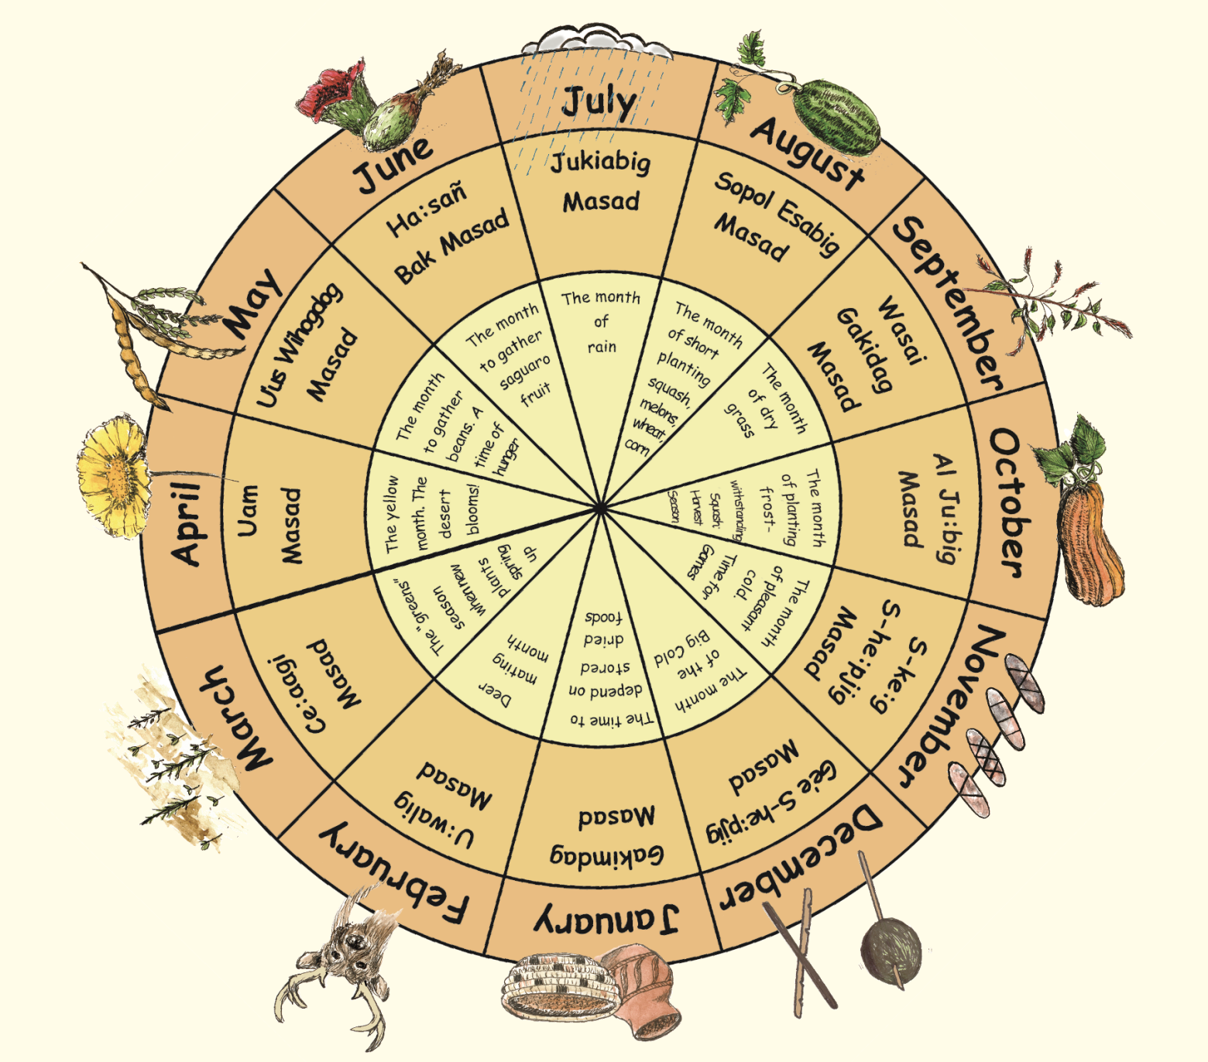
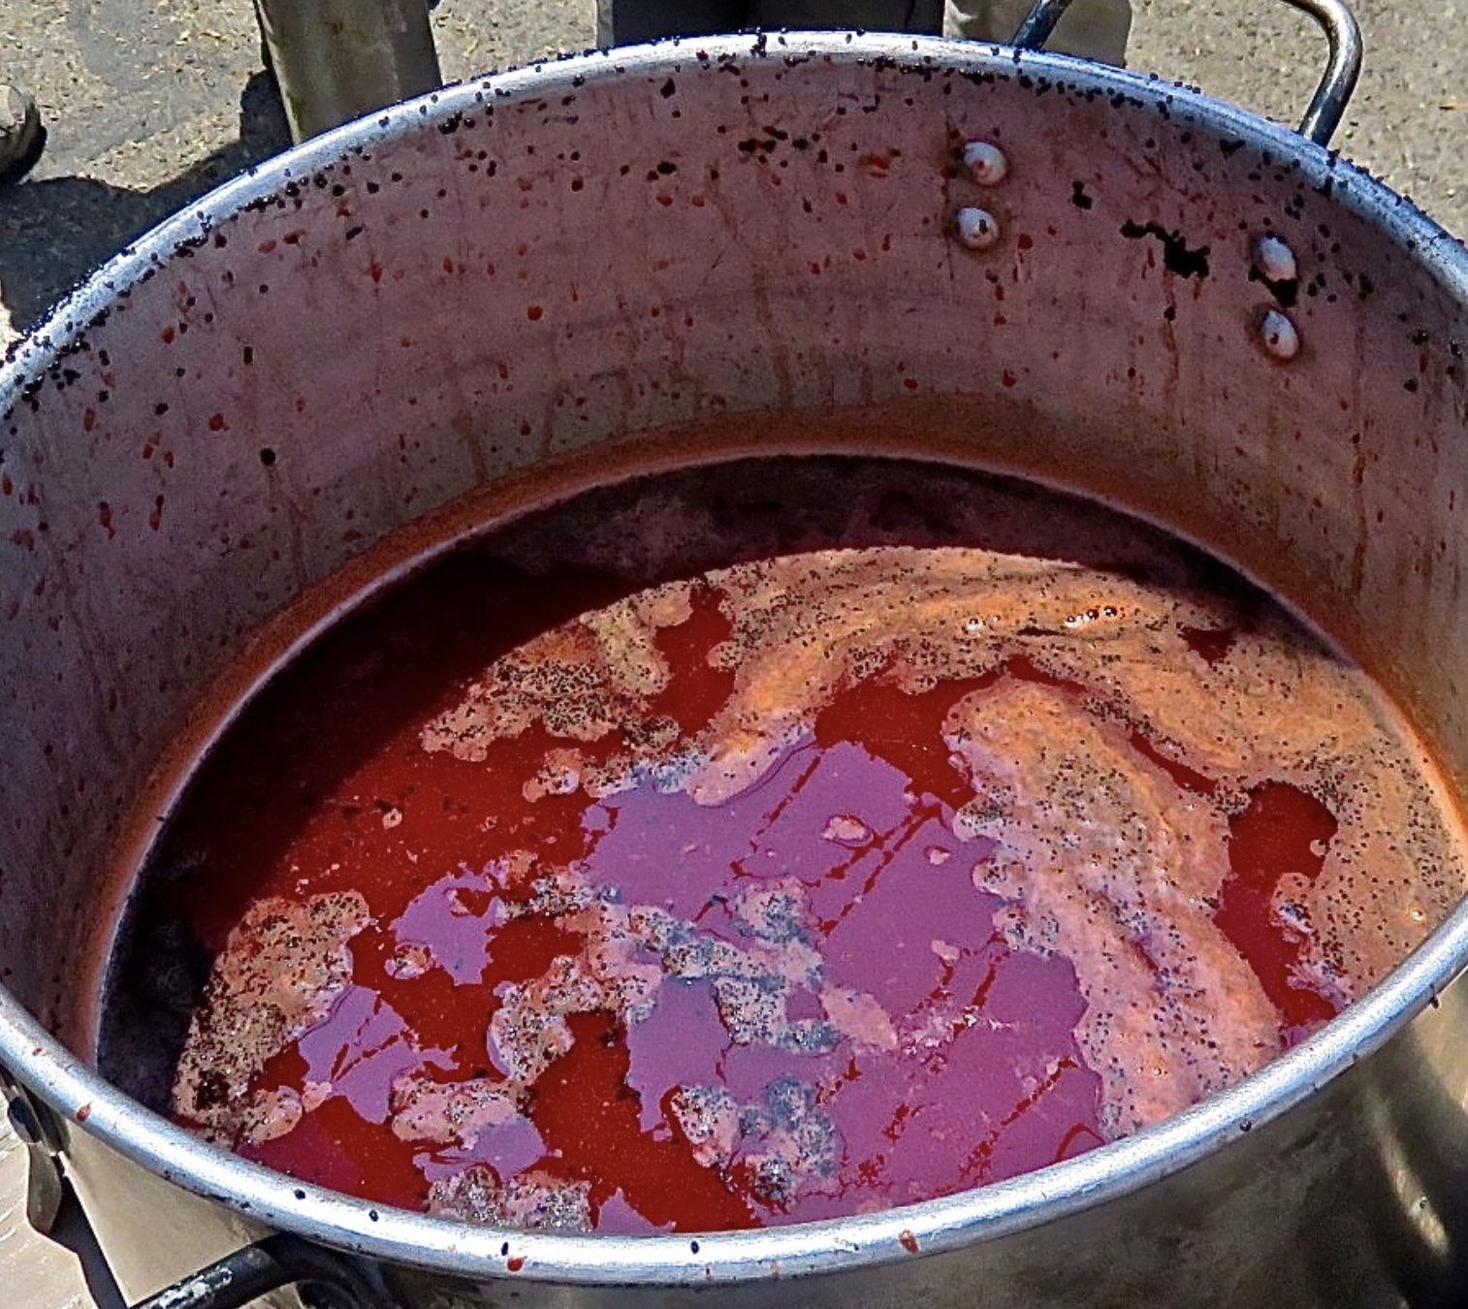
The Saguaro and the Tohono O’odham
Explain
The first people to live in the Tucson area, ever, are the Tohono O’odham. In fact, they gave Tucson its name! That means that Tucson and the surrounding towns were built on the ancestral (originally) Tohono O’odham land. And they still live here today!
The saguaro is very important to the Tohono O’odham. They call it Ha:şañ (ha-shawn). They treat them with the same respect as people. As you’ve seen, they harvest the fruit. They use it to make syrup! Their calendar begins in June, when it’s time to harvest the saguaro fruit.
Bahidaj, or saguaro fruit.

Slide 8
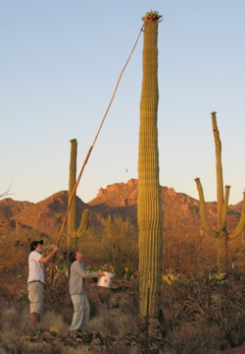
The Saguaro and the Tohono O’odham
Explain
The ribs of the saguaro are used to make the Kuipad (pole) that helps the Tohono O’odham harvest fruit from other saguaros. The ribs can also be used to make furniture, fences, and shades.
The seeds of a saguaro can be dried and made into flour. The seeds can also be used to feed animals, like chickens.
The boot of a saguaro can be helpful for storing things, like water!

Slide 9
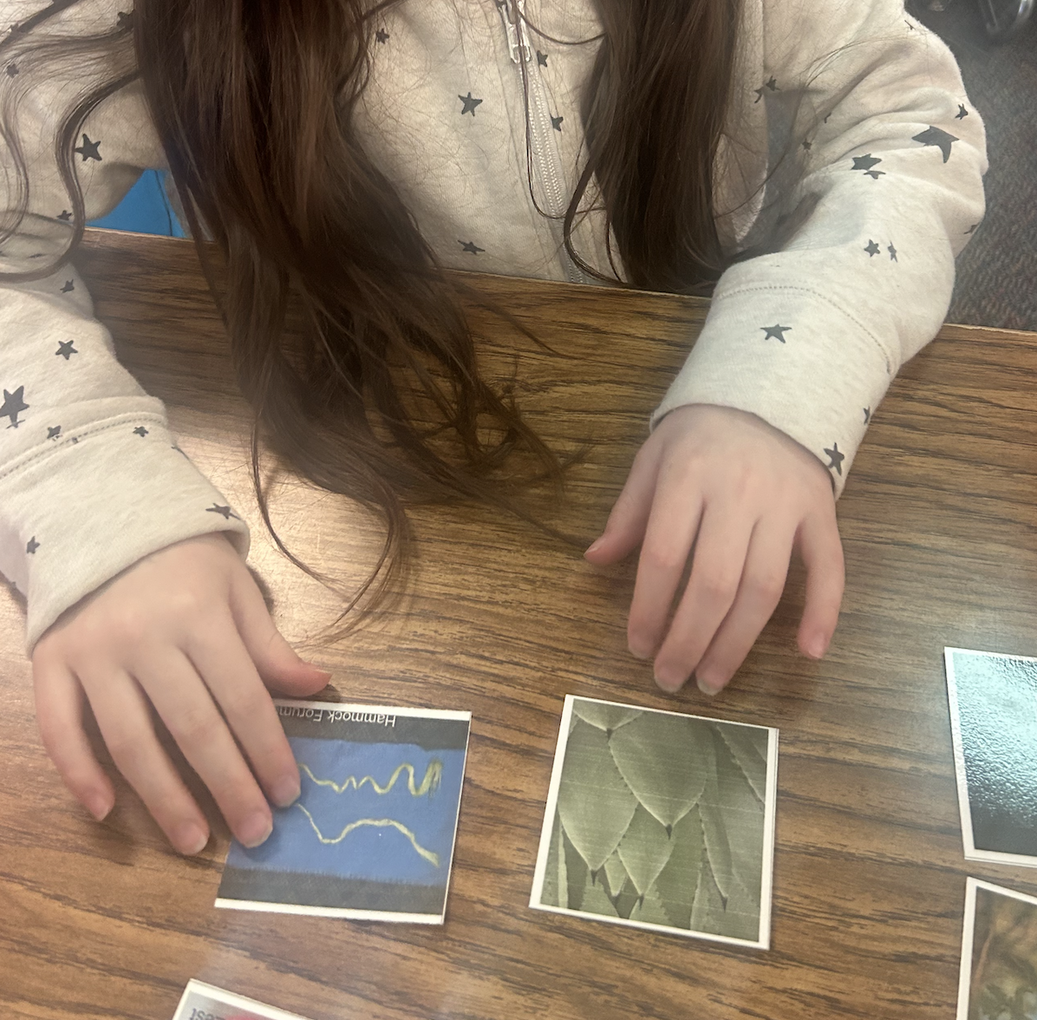
How do we use these desert plants?
Elaborate
The saguaro isn’t the only desert plant humans have used to survive, and the fruit isn’t the only useful part of a saguaro. Today, you are going to look at some pictures of other desert plants. How do you think humans may use them?
Try and find the picture matches. Each plant has an item photo to match!
After you’ve done your sort, we will go over the plant pairs! Then you will have a chance to make changes to your sort and see what matches you correctly found!

Slide 10
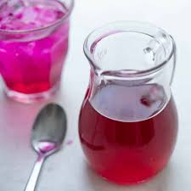
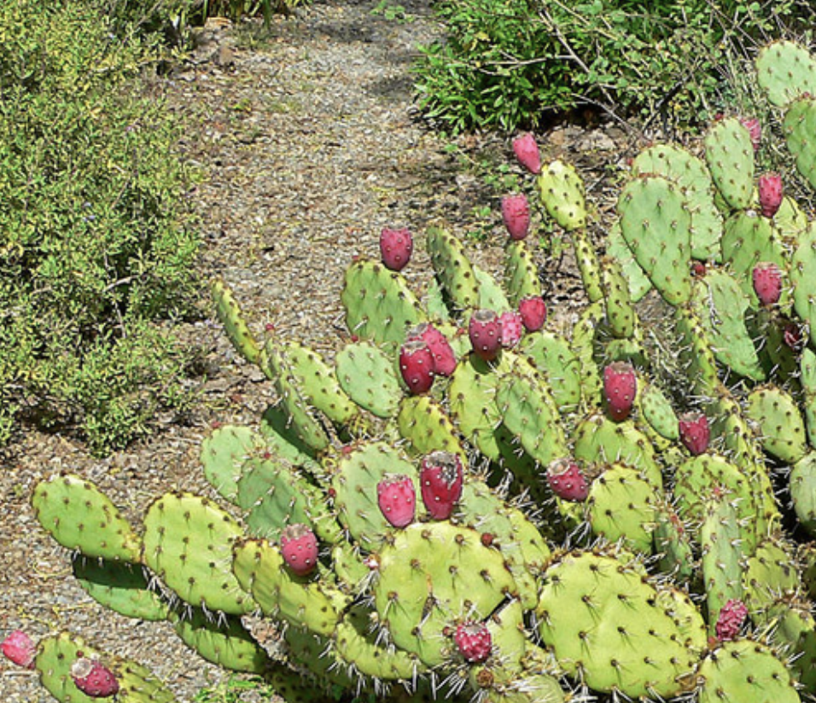
How do we use these desert plants?
Elaborate/Explain
Now that you’ve had a chance to think about how each desert plant might be used, let’s talk about them a little more!
Prickly Pears make a great snack! We can use the fruit to make syrups for all kinds of yummy treats, like candy. We can also eat the pads of the plant. You can find them in some Arizona grocery stores!
Garlic & Zest

Slide 11
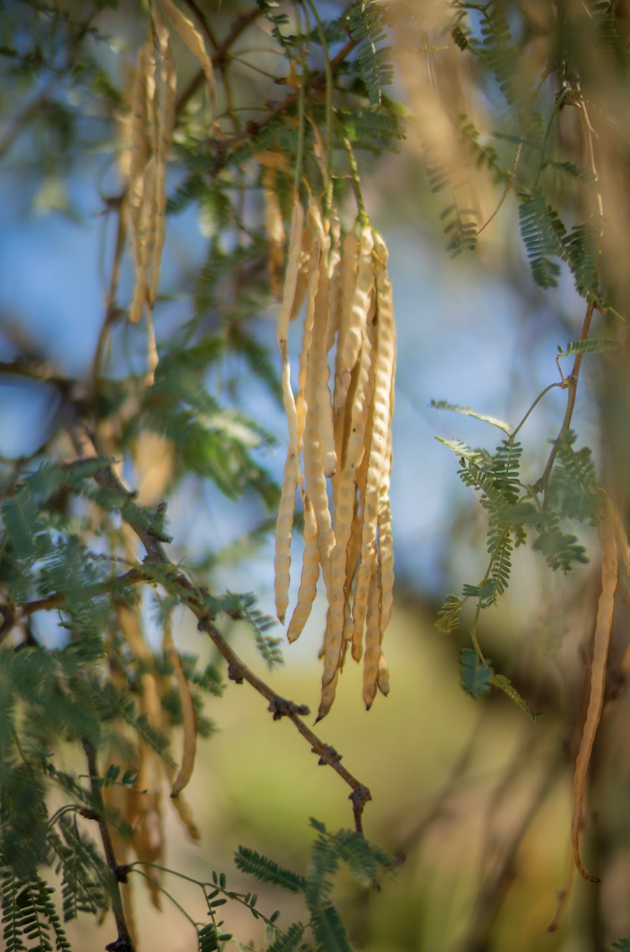
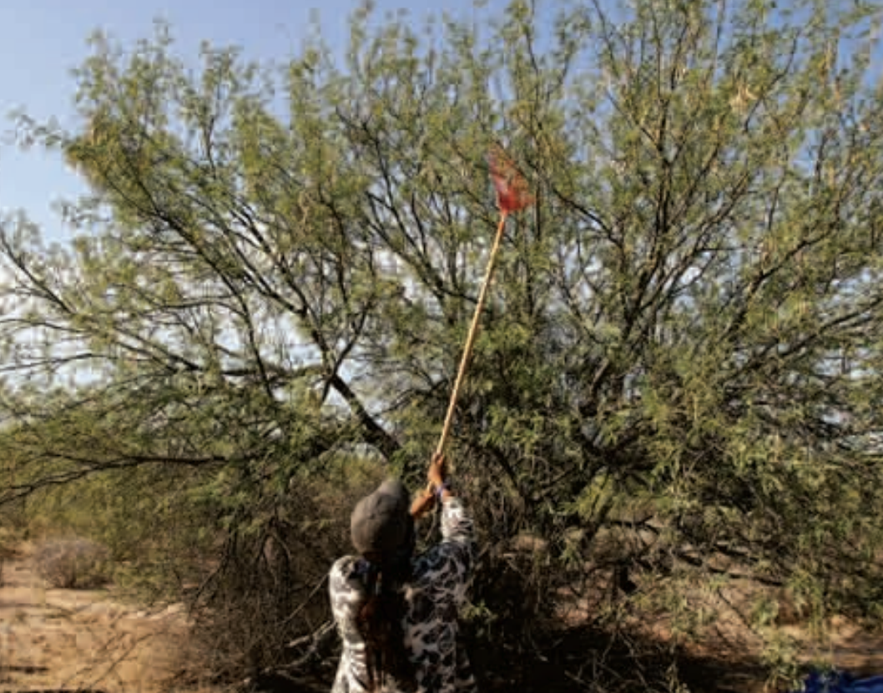
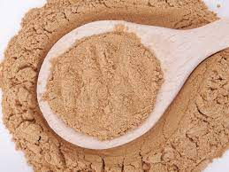
Elaborate/Explain
Mesquite Pods can be ground up to make flour that is used for cooking.
The wood of a mesquite tree is also used to make furniture and wood chips for grilling meat.
Organifi

Slide 12
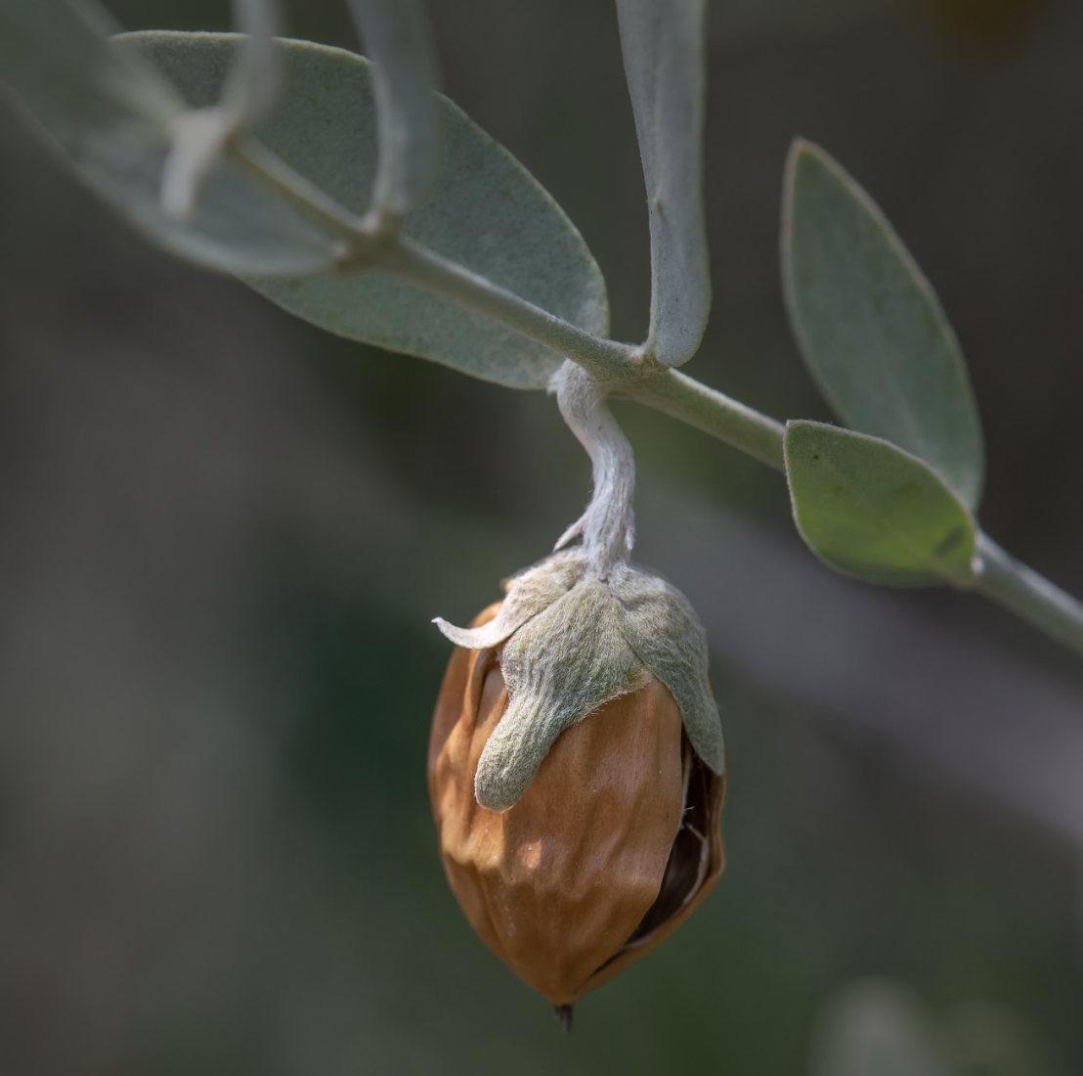
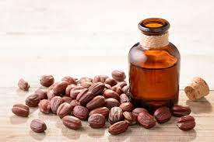
Elaborate/Explain
Jojoba beans (ho-ho-ba) contain a lot of oil, which is like a very waxy liquid. Jojoba oil is used to make salves for cuts. The oil is also used in lots of skin care products.
Prevention.com

Slide 13
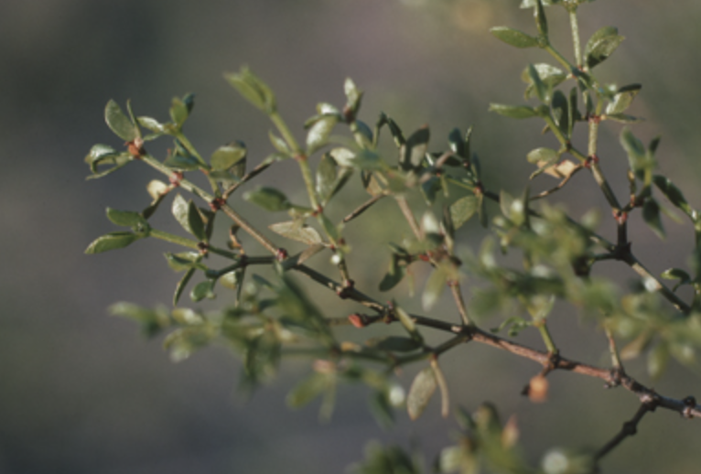
Elaborate/Explain
Creosote is an herb that O’odham peoples have used in medicines for a long time. You have probably smelled creosote if you’ve gone outside after it rains and thought, “Ooh that smells good!” Many people use creosote today in soaps and candles to enjoy it’s clean and fresh smell.

Slide 14
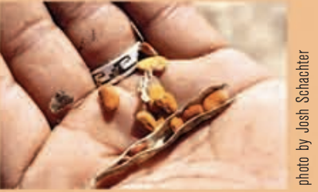
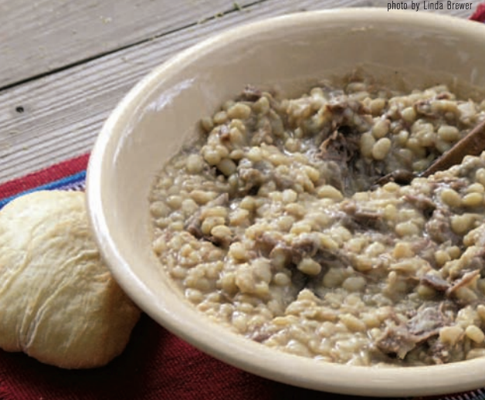
Elaborate/Explain
Tepary beans are another important plant to the Tohono O’odham people. The beans are very nutritious, with lots of good protein, vitamins, and minerals. They are used in soups and stews.
The beans are so important to the people that they have stories about how the plant came to be that have been passed down for generations.

Slide 15
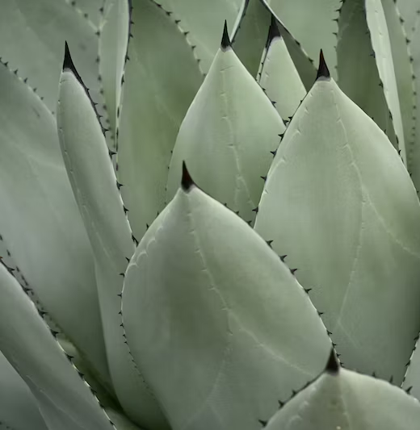
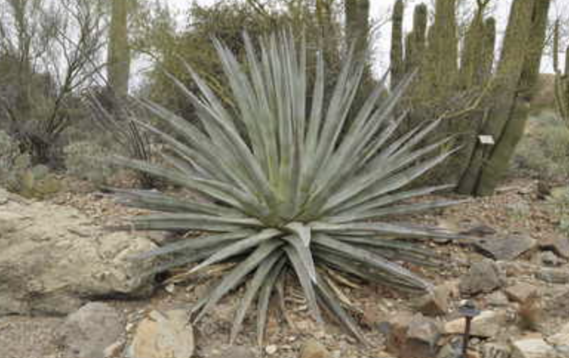
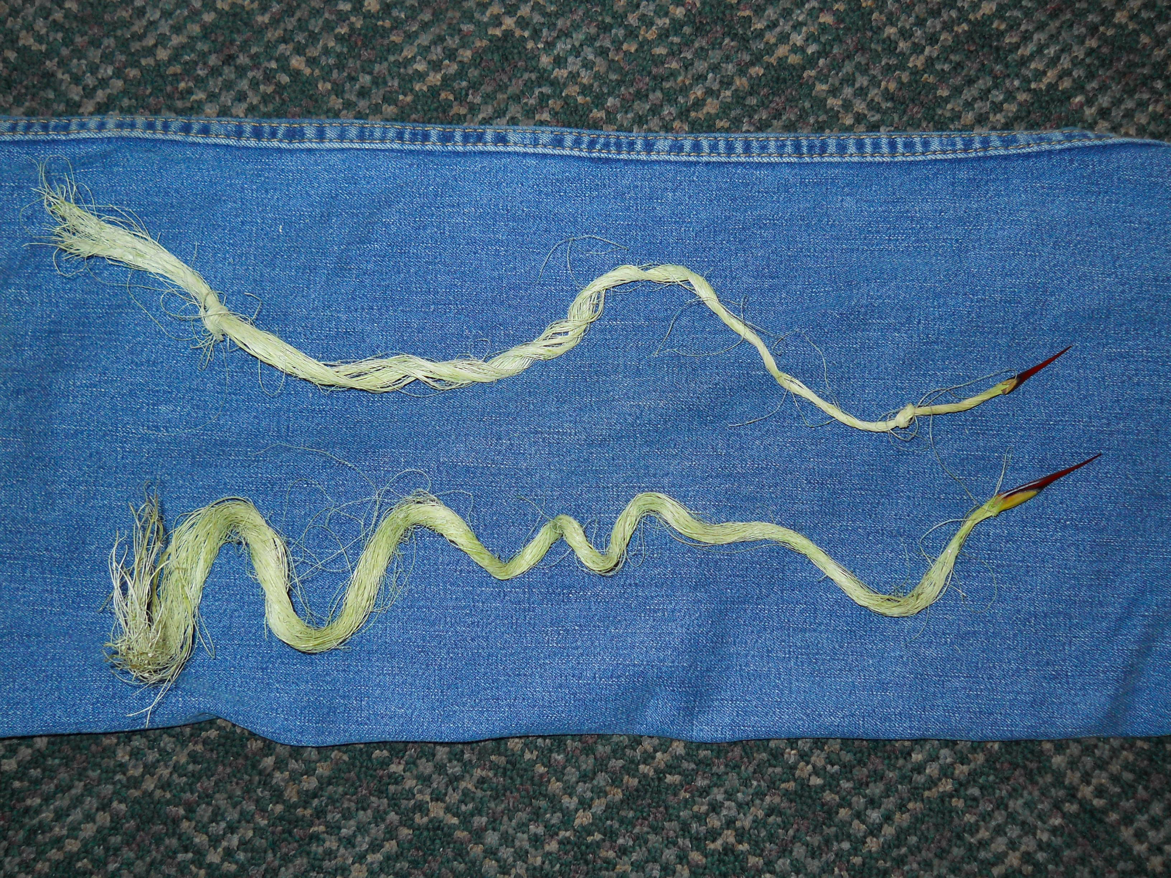
Elaborate/Explain
Agave plants have many uses! People have used them as a source of food, to make fences, to make rope, and to make medicines.
The Hohokam people grew, harvested, and baked agave for eating. They would then scrape the leaves to get to the agave fibers, which make yarn and rope. The needles of the agave can be used with the fibers to sew.
Hammock Forums

Slide 16
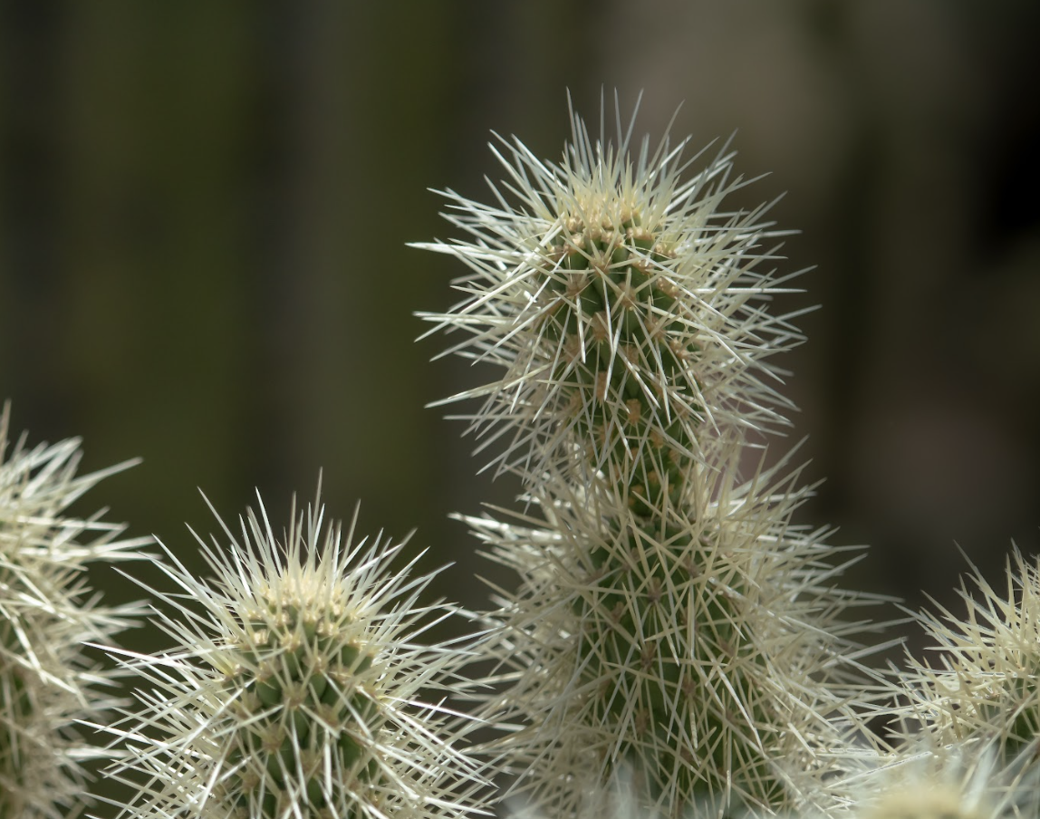
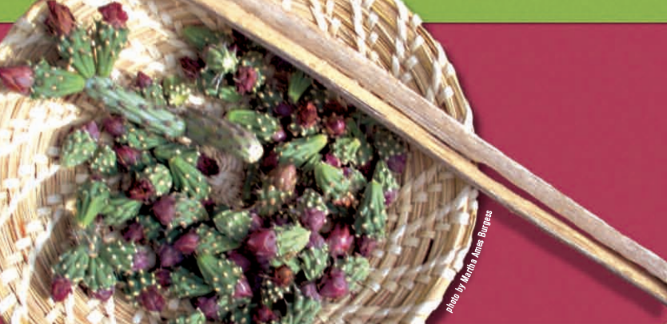
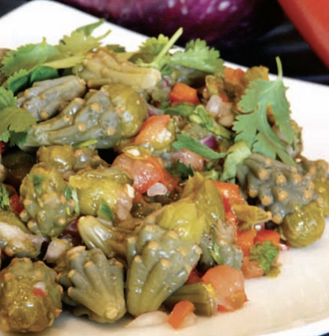
Elaborate/Explain
Cholla buds make another great snack! They are high in calcium and full of fiber, which keeps you full and healthy. Tohono O’odham people harvest cholla buds to eat.
Hammock Forums

Slide 17
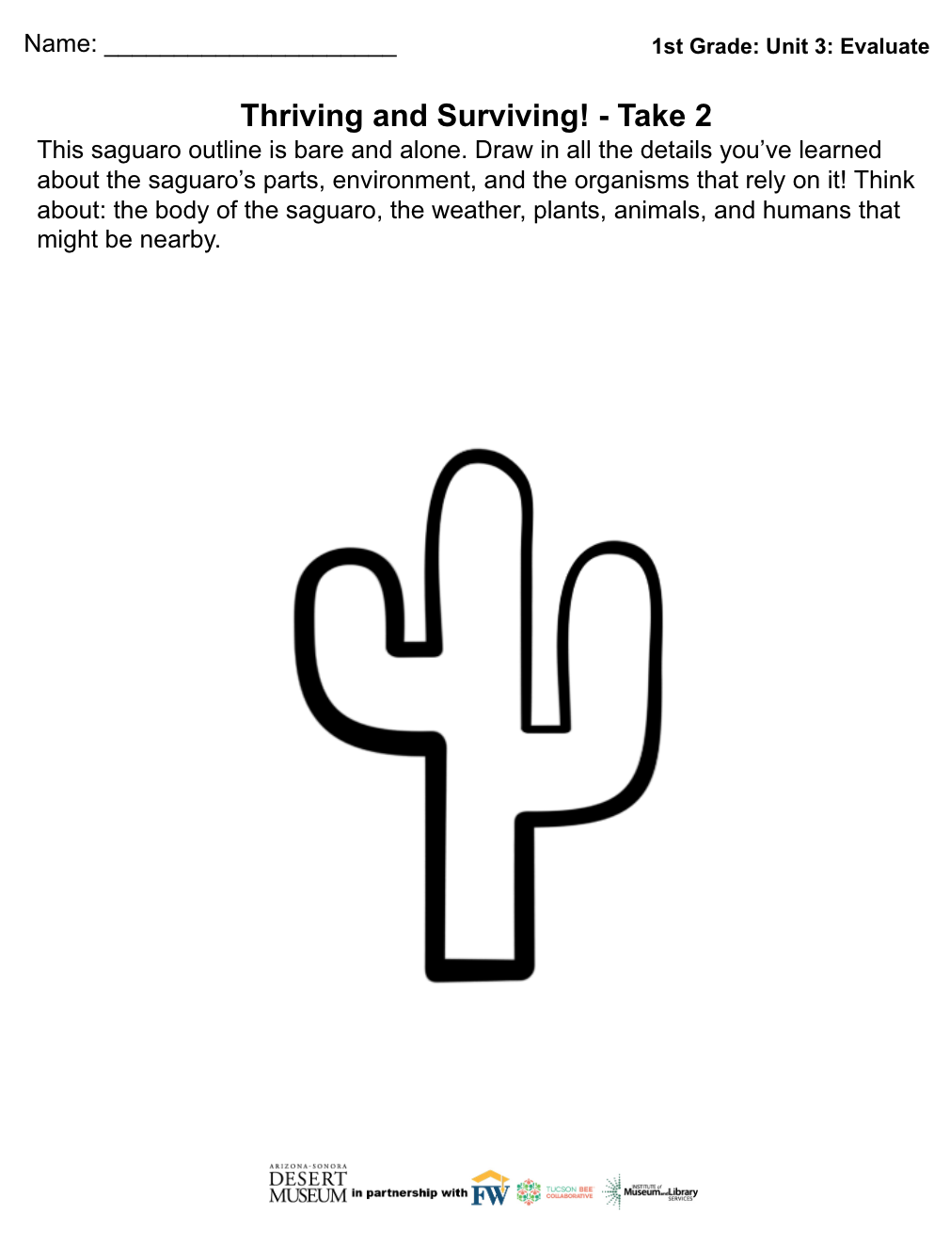
Evaluate
Saguaro Science Experts
You have learned a lot about the saguaro - how it survives, how other organisms use it, and how humans use it! Today you will get a paper with an outline of a saguaro. Show what you’ve learned by drawing the unique parts of the saguaro, the organisms nearby, the ideal weather conditions, and the humans who use it. The more detail, the better!
Notes:
Now students draw a saguaro in detail and in conditions where it would thrive (sunny or some rain, a nurse tree nearby, roots underground, etc.)

Slide 18
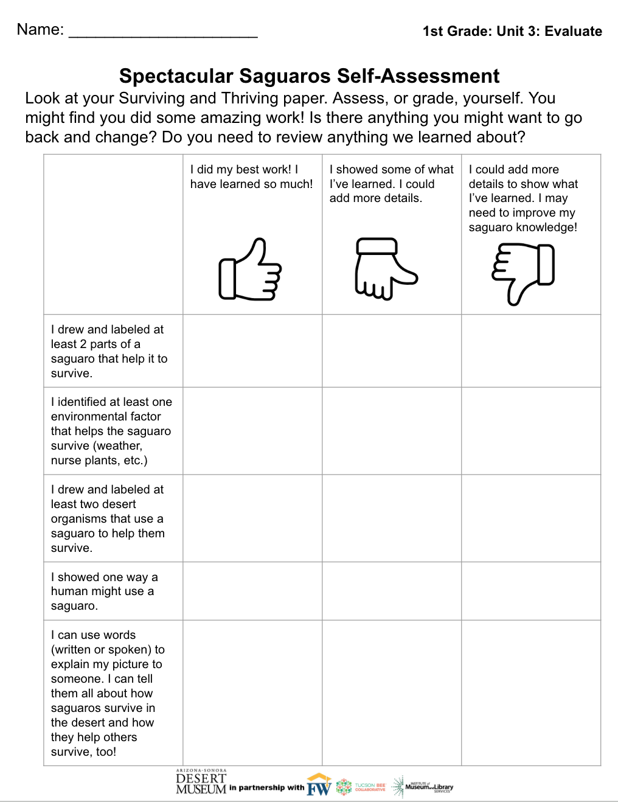
Evaluate
Saguaro Science Experts
Compare your “Surviving and Thriving” papers from week 1 and from this week. What do you notice about your saguaro knowledge? Teachers: Guide students through this self assessment. What did they do well? What could they go back and add to their work?

Slide 19
Extension
Saguaro Poems
Write an acrostic poem about the saguaro. You can use this word bank to help you! What words might you add?
Word Bank
skin flower sun stem
waxy fruit boot flesh
green bloom owls nest
pleats grow bats nurse tree
spines arms birds
water swell coyotes
shade organisms bees
pointy roots insects
Notes:
Teachers- Consider submitting poems to the Desert Museum’s Earth Day Poetry Contest! Find details on the Desert Museum website: https://www.desertmuseum.org/kids/events_poetry.php

Slide 20
Extension
Saguaro Stories
Imagine you are a saguaro! Write a story about your life. Who comes to visit you? What happens if it rains? Draw a picture to match. Later, you can share your story by reading it to a friend!
Notes:
Extension: Have students write stories as if they are saguaros. They can write about what they might do in the rain, who might come visit them, etc.

